Slide 1
Exploring Global Business

Slide 2
Learning Objectives
Explain the economic basis for international business.
Discuss the restrictions nations place on international trade, the objectives of these restrictions, and their results.
Outline the extent of international trade and identify the organizations working to foster it.
Discuss international trade agreements and international economic organizations working to foster trade.
Define the methods by which a firm can organize for and enter into international markets.
Describe the various sources of export assistance.
Identify the institutions that help firms and nations finance international business.

Slide 3
The Basis for International Business
International business
  All business activities that involve exchanges across national boundaries
Some countries are better equipped than others to produce particular goods or services
  Absolute advantage
    The ability to produce a specific product more efficiently
    than any other nation
  Comparative advantage
    The ability to produce a specific product more efficiently
    than any other product
Goods and services are produced more efficiently when each country specializes in the products for which it has a comparative advantage

Slide 4
The Basis for International Business (cont’d)
Countries trade when they each have a surplus of the product they specialize in and want a product the other country specializes in
Exporting
  Selling and shipping raw materials or products
  to other nations
Importing
  Purchasing raw materials or products in other nations and bringing them into one’s own country

Slide 5
The Basis for International Business (cont’d)
Balance of trade
  The total value of a nation’s exports minus the total value of its imports over some period of time
Trade deficit
  A negative (unfavorable) balance of trade—imports exceed exports in value
Balance of payments
  The total flow of money into a country minus the total flow of money out of that country over a period of time

Slide 6
Restrictions to International Business
The reasons for restricting trade range from internal political and economic pressures to mistrust of other nations.
Nations are generally eager to export their products to provide markets for their industries and develop a favorable balance of trade.
Most trade restrictions are applied to imports from other nations.

Slide 7
Types of Trade Restrictions
Import duty (tariff)
  A tax levied on a particular foreign product entering
  a country
    Revenue tariffs are imposed to generate income for the government
    Protective tariffs are imposed to protect a domestic industry from competition by keeping the prices of imports at or above the price of domestic products
Dumping
  The exportation of large quantities of a product at a price lower than that of the same product in the home market

Slide 8
Types of Trade Restrictions (cont’d)
Nontariff barriers
  Nontax measures imposed by a government to favor domestic over foreign suppliers
  Import quota—a limit on the amount of a particular good that may be imported during a given time
  Embargo—a complete halt to trading with a particular nation or in a particular product
  Foreign exchange control—restriction on amount of foreign currency that can be purchased or sold

Slide 9
Types of Trade Restrictions (cont’d)
Nontariff barriers (cont’d)
  Currency devaluation—the reduction of the value of a nation’s currency relative to the currencies of other countries
  Bureaucratic red tape—subtly imposes unnecessarily burdensome and complex standards and requirements for imported goods
  Cultural attitudes—can impede acceptance of products in foreign countries

Slide 10
The Extent of International Business
Although the worldwide recessions of 1991 and 2001-2002 slowed the rate of growth, and 2008-2009 global economic crisis caused the sharpest decline in more than 70 years, globalization is a reality of our time
In the U.S., international trade accounts for over ¼ of GDP

Slide 11
The Extent of International Business (cont’d)
Trade barriers are decreasing, new competitors are entering the global marketplace, creating more choices for consumers and new job opportunities
International business will grow with the expansion of commercial use of the Internet

Slide 12
The World Economic Outlook for Trade
Economic performance among nations is not equal; growth in advanced countries slowed and then stopped in 2009, while emerging and developing economies continue to grow rapidly
International experts expected global economic growth in 2010 and 2011, despite the high oil prices

Slide 13
The World Economic Outlook for Trade (cont’d)
Canada and Western Europe
  Canada is projected to show growth in 2010
  and 2011
  Euro area is expected to grow in 2011
  U.K. and smaller European countries are expected to experience a recession
Mexico and Latin America
  Mexico is expected to show growth in 2010
  and 2011
  Latin America and Caribbean economies are recovering at a robust pace

Slide 14
The World Economic Outlook for Trade (cont’d)
Japan
  Projected to show growth in 2010 and 2011
Other Asian Countries
  Lead by China emerging as a global economic power, growth is strong
  Key emerging economies is Asia are leading the global recovery
Emerging Europe
  Growth has been faster than in western Europe and continued growth is expected in 2010 and 2010

Slide 15
The World Economic Outlook for Trade (cont’d)
Commonwealth of Independent States
  Projected to show growth in 2010 and 2011
  With the collapse of communism, trade between the U.S. and central and Eastern Europe expanded substantially
Exports and the U.S. Economy
  In 2008, exports as a percentage of GDP reached its highest level since 1916
  In the past 50 years, exports have become increasingly important to the U.S. economy

Slide 16
International Trade Agreements
The General Agreement on Tariffs and Trade and the World Trade Organization
  General Agreement of Tariffs and Trade (GATT)
    International organization of 153 nations dedicated to reducing or eliminating tariffs and other trade barriers
    Most-favored-nation status (MFN)—Each member of GATT was to be treated equally by all other members
    Kennedy Round, Tokyo Round, Uruguay Round, Doha Round

Slide 17
International Trade Agreements (cont’d)
The General Agreement on Tariffs and Trade and the World Trade Organization (cont’d)
  World Trade Organization (WTO)
    Created in the Uruguay Round of GATT negotiation as a successor to GATT
    WTO oversees GATT provisions, has judicial powers to meditate trade disputes arising from GATT rules and exerts more binding authority
    than GATT

Slide 18
International Economic Organizations
Working to Foster Trade
Economic community
  An organization of nations formed to promote the free movement of resources and products among its members and to create common economic policies

Slide 19
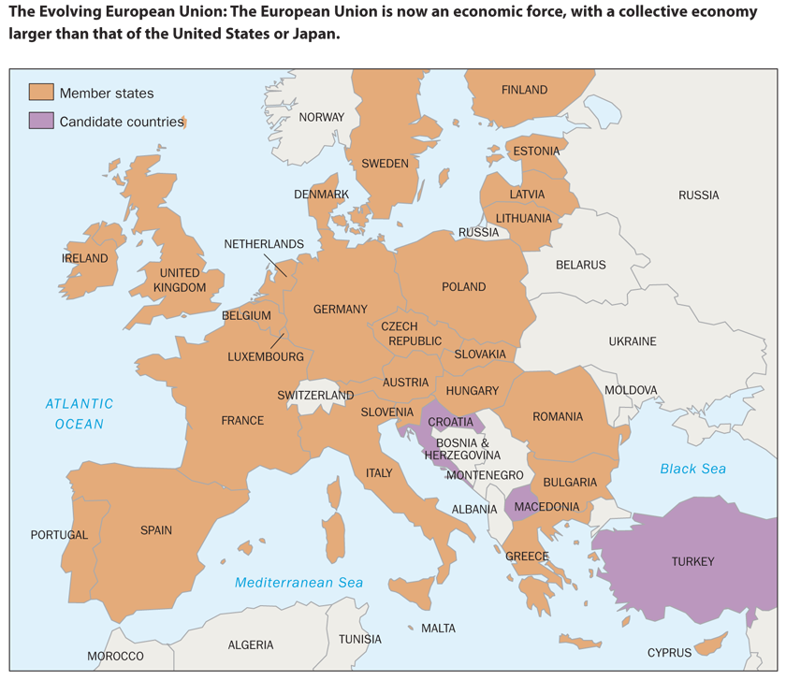
The Evolving European Union
FIGURE 3-5
Source: http://europa.eu/abc/european_countries/index_en.htm, accessed May 25, 2010.

Slide 20
International Economic Organizations
Working to Foster Trade (cont’d)
North American Free Trade Agreement
(NAFTA)
United States
Canada
Mexico
Chile is expected to become the 4th member

Slide 21
International Economic Organizations
Working to Foster Trade (cont’d)
Central American Free Trade Agreement – Dominican Republic (CAFTA-DR)
El Salvador
Guatemala
Honduras
Nicaragua
Dominican Republic
Costa Rica

Slide 22
International Economic Organizations
Working to Foster Trade (cont’d)
Association of Southeast Asian Nations (ASEAN)
Brunei
Myanmar
Cambodia
Indonesia
Laos
Malaysia
Philippines
Singapore
Thailand
Vietnam

Slide 23
International Economic Organizations
Working to Foster Trade (cont’d)
European Economic Area (EEA)
Pacific Rim
Commonwealth of Independent States (CIS)
Caribbean Basin Initiative (CBI)
Common Market of the Southern Cone (MERCOSUR)
Organization of Petroleum Exporting Countries (OPEC)
Organization for Economic Cooperation and Development (OECD)

Slide 24
Methods of Entering
International Business
Licensing
  A contractual agreement in which one firm permits another to produce and market its product and use its brand name in return for a royalty or other compensation
  Advantage
    It allows expansion into foreign markets with
    little or no direct investment
  Disadvantages
    The product image may be damaged if
    standards are not upheld
    The original producer does not gain foreign
    marketing experience

Slide 25
Methods of Entering
International Business (cont’d)
Exporting
  May use an export/import merchant who assumes the risks of ownership, distribution, and sale
  Letter of credit - Issued by a bank on request of an importer stating that the bank will pay an amount of money to a stated beneficiary
  Bill of lading - Issued by a transport carrier to an exporter to prove merchandise has been shipped
  Draft - Issued by the exporter’s bank, ordering the importer’s bank to pay for the merchandise, thus guaranteeing payment once accepted by the importer’s bank

Slide 26
Methods of Entering
International Business (cont’d)
Exporting (cont’d)
  May use an export/import agent who arranges sale for a commission or fee; the exporter retains title to products until they are sold
  May establish own sales offices or branches in foreign countries

Slide 27
Methods of Entering
International Business (cont’d)
Joint ventures
  A partnership formed to achieve a specific goal
  or to operate for a specific period of time
  Advantages
    Immediate market knowledge and access
    Reduced risk
    Control over the product attributes
  Disadvantages
    Complexity of establishing agreements across national borders
    High level of commitment required of all
    parties involved

Slide 28
Methods of Entering
International Business (cont’d)
Totally owned facilities
  Production and marketing facilities in one or more foreign nations
  Advantage
    Direct investment provides complete control
    over operations
  Disadvantage
    Risk is greater than that of a joint venture
  Two forms
    Building new facilities in the foreign country
    Purchasing an existing firm in the foreign country

Slide 29
Methods of Entering
International Business (cont’d)
Strategic alliances
  Partnerships formed to create competitive advantage on a worldwide basis
Trading companies
  Firms that provide a link between buyers and sellers in different countries
  Takes title to products and perform all the activities necessary to move the products from one country to another

Slide 30
Methods of Entering
International Business (cont’d)
Countertrade
  An international barter transaction
  Avoids restrictions on converting domestic currency to foreign currency
Multinational enterprise
  A firm that operates on a worldwide scale without ties to any specific nation or region

Slide 31
Sources of Export Assistance
National Export Strategy (NES)
  Trade Promotion Coordinating Committee (TPCC)
    Assists U.S. firms in developing
    export-promotion programs
    Help American firms compete in foreign
    markets and create new jobs in the U.S.

Slide 32
Financing International Business
The Export-Import Bank of the United States (Eximbank)
  An independent agency of the U.S. government whose function it is to assist in financing the exports of American firms
Multilateral Development Bank (MDB)
  An internationally supported bank that provides loans to developing countries to help them grow
    World Bank, Inter-American Development Bank (IDB), Asian Development Bank (ADB), African Development Bank (AFDB), European Bank for Reconstruction and Development (EBRD)
The International Monetary Fund (IMF)
  An international bank with 186 member nations that makes short-term loans to developing countries experiencing
  balance-of-payment deficits

